Slide 1
Tel Aviv Mob

Slide 2
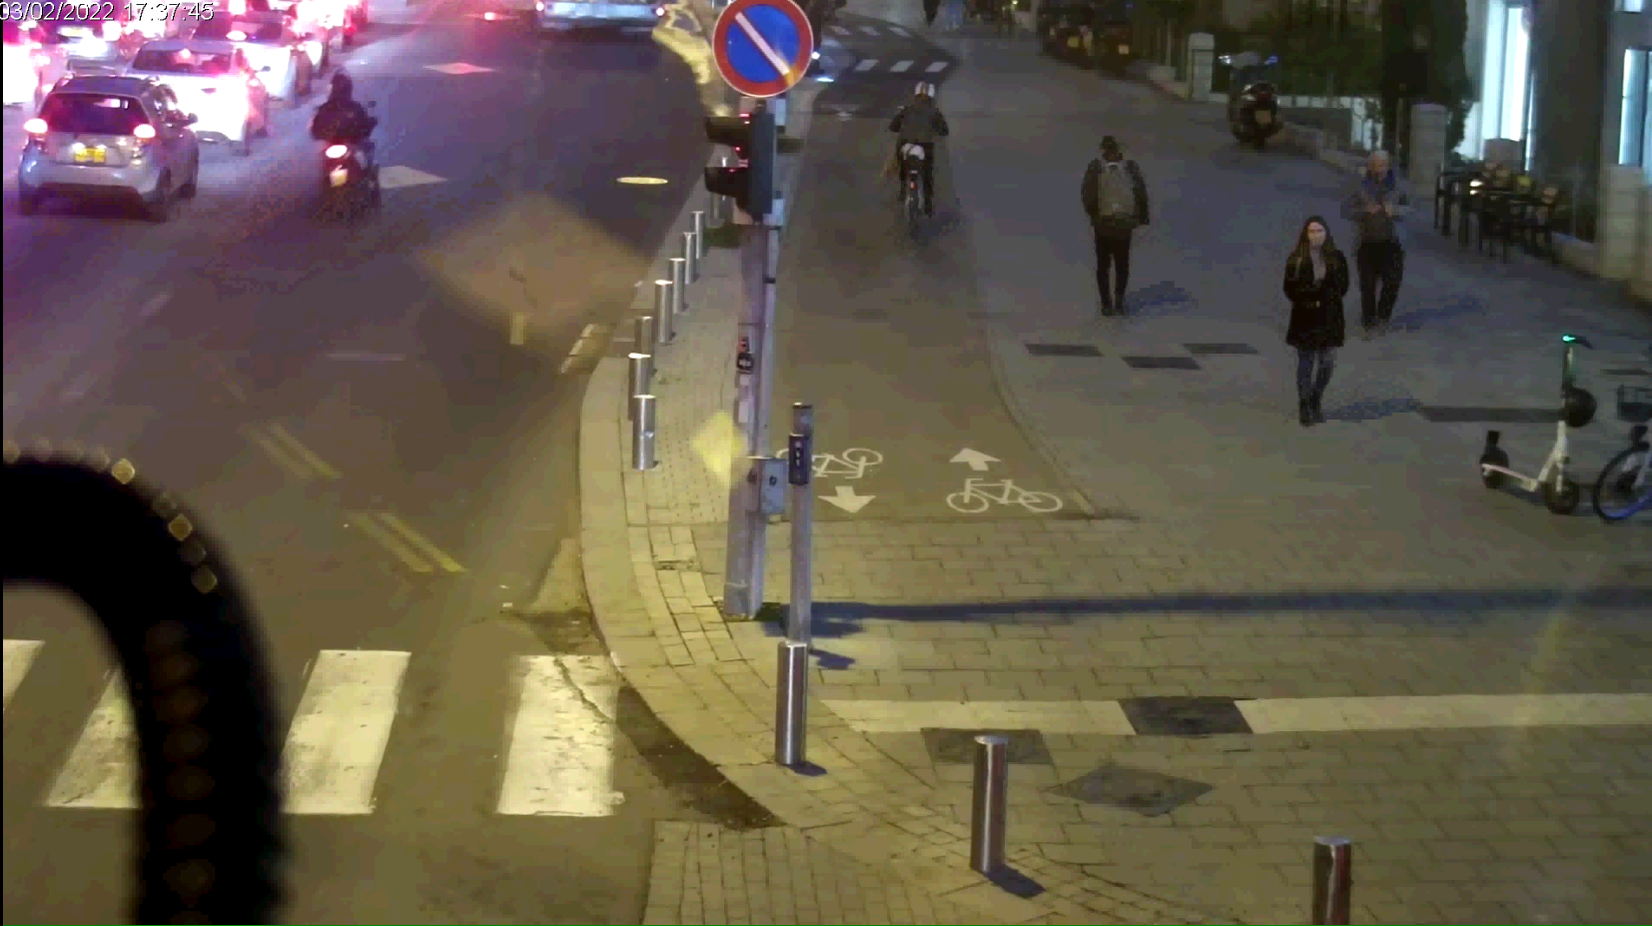
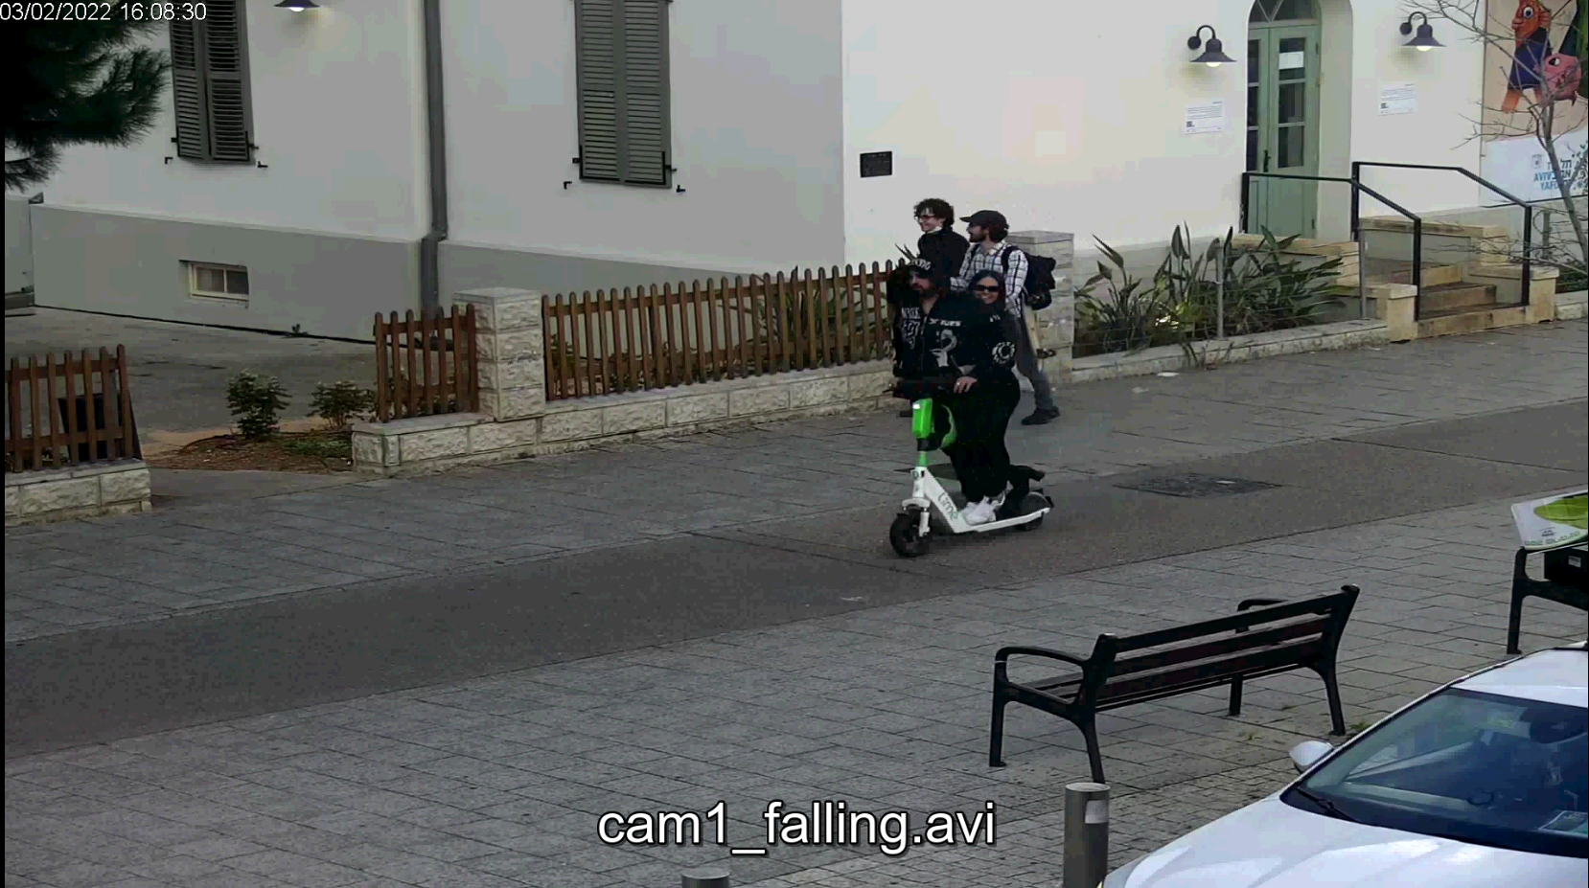
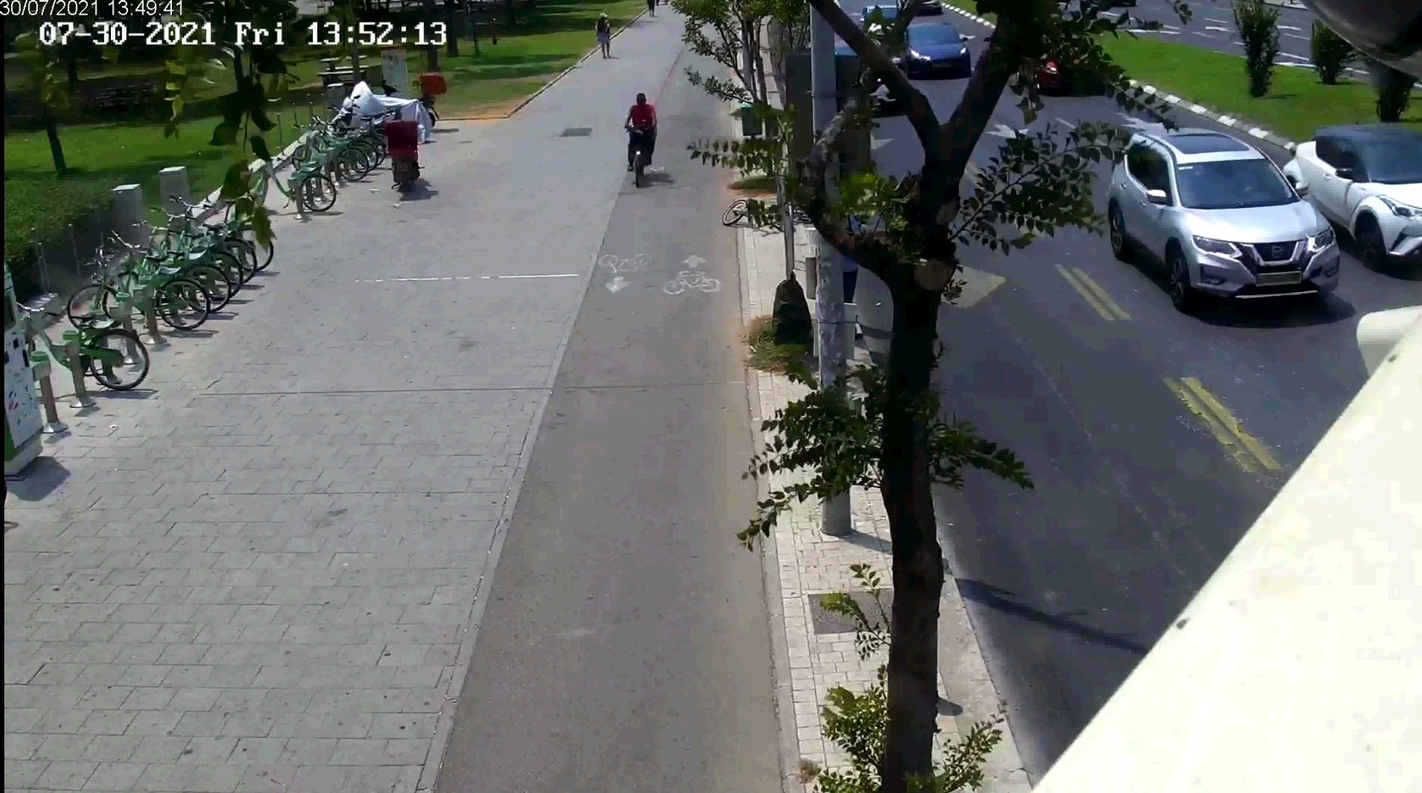
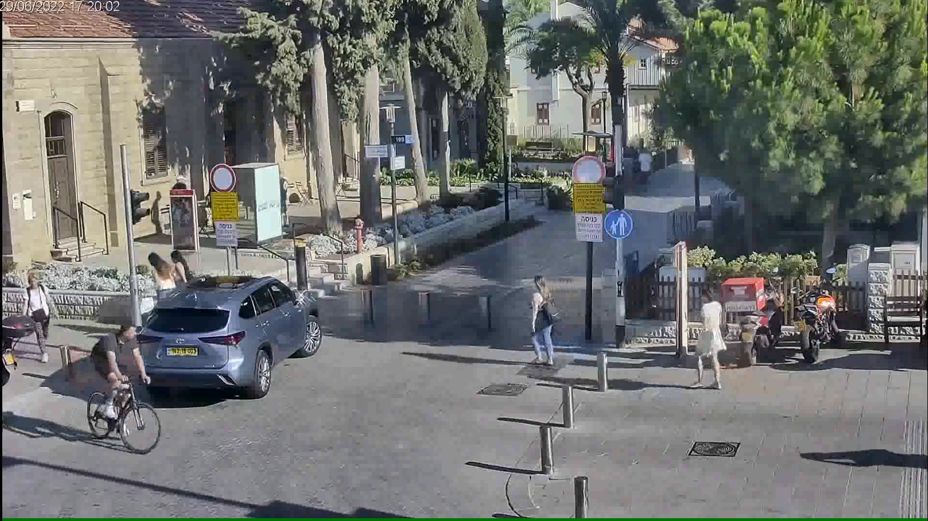

Slide 3
Classification of the road user:
Pedestrians
Scooter
Bicycles
Motorcycles
Vehicles (Car, Truck, Bus, Van etc.)

Slide 4
Use cases
Identifying an obstacle on the bicycle path - leaving a micromobility device and a cardboard box
Identification of a person lying on the bicycle path for the minimum amount of time defined in the system configuration
Identifying crowds on the bicycle path. The number of people gathering and the minimum time for gathering are defined in the system configuration
Identification of unauthorized vehicles on the trail – motorcycle, private vehicle, van, truck and bus (assuming all vehicles are in the camera's view)
Counting roadusers (except pedestrian)* according to their classification and direction of travel
Speed measurement of roadusers (except pedestrian) including overspeeding (25 km/h)
Driving a road user off the bike path in an unauthorized area
Riding without a helmet
Riding more than one rider on a scooter

Slide 5
Model
Detector
1. Head + Person -> Yolov5m CrowdHuman -> Yolo11m?
2. Vehicle + Box + AbandonePMD -> Yolo11m?
Classifier:
1. PMD Classifier
2. Helmet Classifier
3. Vehicle Classifier ?
Pose:
1. Hrnet Pose

Slide 6
Yolo11 for Vehicle and Box(Package)
Dataset:
Vehicle Data from Coco (Partially) –> images that might contain package?
Package dataset from Roboflow -> remove images that contain vehicle "X:\ML_Dataset\Package V2.v4i.yolov8"

Slide 7
Yolo11 for Vehicle and Box(Package)
Use a Pretrained Model:
Start with a YOLOv8 model that has been pretrained on the COCO dataset. This model already knows how to detect the 80 COCO classes.
2. Expand the Model's Final Layer:
Modify the model's architecture such that the final classification layer can predict the additional classes. For YOLOv8, this means adjusting the number of output classes from 80 to 83.
3. Custom Dataset:
Create a dataset that includes your custom class images labeled appropriately.
4. Combined Dataset:
Integrate your custom dataset with relevant examples from the COCO dataset. This is necessary because you want the model to continue recognizing the original classes, and mixing COCO data with your new examples helps to maintain this ability.

Slide 8
Yolo11 for Vehicle and Box(Package)
5. Soft Weight Loading:
When initiating training, make sure to use a training approach that loads the weights for the existing layers (especially the earlier layers that capture generic features) but adapts the weights of the final layers to accommodate the new classes.
6. Fine-Tuning:
Carefully fine-tune/transfer learn on the combined dataset so that the pretrained model learns to recognize the new classes without losing its ability to recognize the original COCO classes. This often involves freezing the earlier layers during the initial phase of training and only allowing the final layers to adjust to the new class data.

Slide 9
Doing this without downloading the entire COCO dataset might require you to use a subset of COCO that contains a variety of examples for each of the 80 classes. You'll want to integrate these examples with your custom class images to create a balanced dataset that the model can fine-tune on.
Please note that care must be taken during this process to avoid catastrophic forgetting, which is when a model forgets previously learned information upon learning new information. Regularization techniques, careful learning rate management, and perhaps techniques like knowledge distillation or replay might be needed to maintain performance across all classes.
To ensure an optimal outcome, it is important to monitor the model's performance on both new and original classes throughout the training process.

